Slide 1
Consciousness
Chapter 4

Slide 2
Chapter 4 Learning Objective Menu
LO 4.1 Consciousness and levels of consciousness
LO 4.2 Why sleep and how sleep works
LO 4.3 Purpose of sleep
LO 4.4 Stages of sleep
LO 4.5 Dreaming and what happens if people do not dream
LO 4.6 Sleepwalking as a defense for committing a crime
LO 4.7 Problems during sleep
LO 4.8 Why people dream and what they dream about
LO 4.9 Hypnosis and how it works
LO 4.10 Physical and psychological dependence on a drug
LO 4.11 Examples and dangers of stimulants
LO 4.12 Types of depressants and how they are harmful
LO 4.13 Alcohol and its dangers
LO 4.14 Narcotics and why they are so addictive
LO 4.15 How hallucinogens work
LO 4.16 Marijuana and its risks
LO 4.17 Sleep deprivation

Slide 3
Consciousness
LO 4.1 Consciousness and levels of consciousness
Consciousness - a person’s awareness of everything that is going on around him or her at any given moment.
Waking consciousness - state in which thoughts, feelings, and sensations are clear, organized, and the person feels alert.
Altered state of consciousness - state in which there is a shift in the quality or pattern of mental activity as compared to waking consciousness.
Menu

Slide 4
Necessity of Sleep
LO 4.2 Why sleep and how sleep works
Circadian rhythm - a cycle of bodily rhythm that occurs over a 24-hour period.
  “circa” – about
  “diem” – day
Hypothalamus – tiny section of the brain that influences the glandular system.
  suprachiasmatic nucleus – deep within the hypothalamus; the internal clock that tells people when to wake up and when to fall asleep.
    Tells pineal gland to secrete melatonin, which makes a person feel sleepy.
Menu

Slide 5
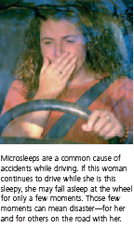

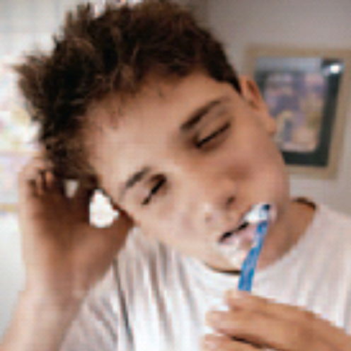
Necessity of Sleep
LO 4.3 Purposes of sleep
Microsleeps - brief sidesteps into sleep lasting only a few seconds.
Sleep deprivation - any significant loss of sleep, resulting in problems in concentration and irritability.
Menu

Slide 6
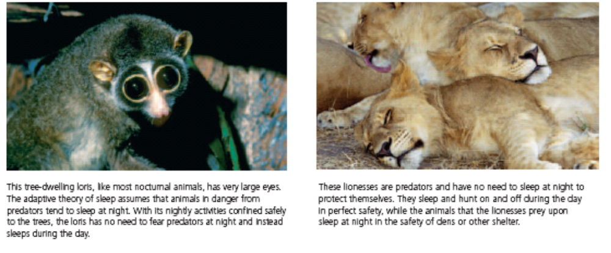
Necessity of Sleep
LO 4.3 Purposes of sleep
Adaptive theory - theory of sleep proposing that animals and humans evolved sleep patterns to avoid predators by sleeping when predators are most active.
Restorative theory - theory of sleep proposing that sleep is necessary to the physical health of the body and serves to replenish chemicals and repair cellular damage.
Menu

Slide 7
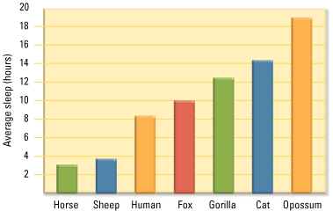
LO 4.3 Purposes of sleep
Menu

Slide 8
Brain Wave Patterns
LO 4.4 Stages of sleep
Electroencephalograph (EEG) - allows scientists to see the brain wave activity as a person passes through the various stages of sleep and to determine what type of sleep the person has entered.
  Alpha waves - brain waves that indicate a state of relaxation or light sleep.
  Theta waves - brain waves indicating the early stages of sleep.
  Delta waves - long, slow waves that indicate the deepest stage of sleep.
Menu

Slide 9
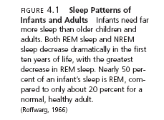
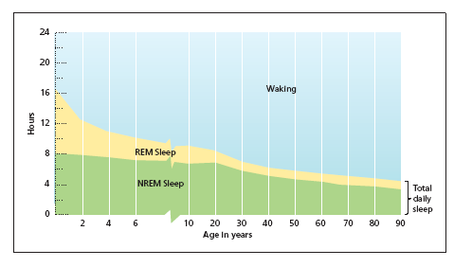
LO 4.4 Stages of sleep
Menu

Slide 10
Stages of Sleep
LO 4.4 Stages of sleep
Rapid eye movement (REM) - stage of sleep in which the eyes move rapidly under the eyelids and the person is typically experiencing a dream.
NREM (non-REM) sleep - any of the stages of sleep that do not include REM.
Menu

Slide 11
Stages of Sleep
LO 4.4 Stages of sleep
Non-REM Stage One – light sleep.
  May experience:
  hypnagogic images – vivid visual events.
  hypnic jerk – knees, legs, or whole body jerks.
Non-REM Stage Two – sleep spindles (brief bursts of activity only lasting a second or two).
Non-REM Stages Three and Four – delta waves pronounced.
  Deep sleep – when 50%+ of waves are delta waves.
Menu

Slide 12
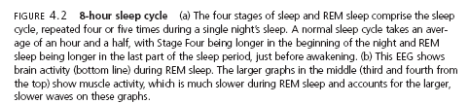
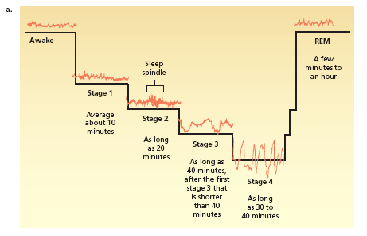
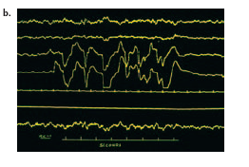
LO 4.4 Stages of sleep
Menu

Slide 13
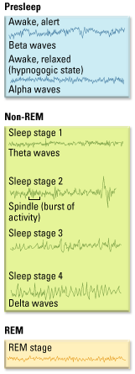
LO 4.4 Stages of sleep
Menu

Slide 14
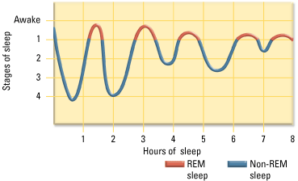
LO 4.4 Stages of sleep
Menu

Slide 15
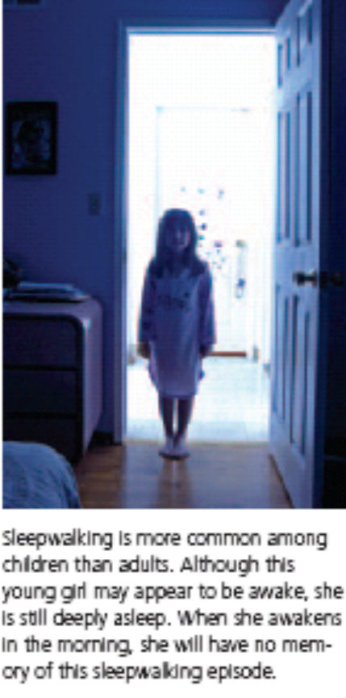
Stage Four Sleep Disorders
LO 4.4 Stages of sleep
Sleepwalking (somnambulism) - occurring during deep sleep, an episode of moving around or walking around in one’s sleep.
Night terrors - relatively rare disorder in which the person experiences extreme fear and screams or runs around during deep sleep without waking fully.
Menu

Slide 16
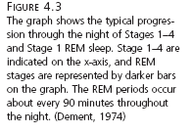
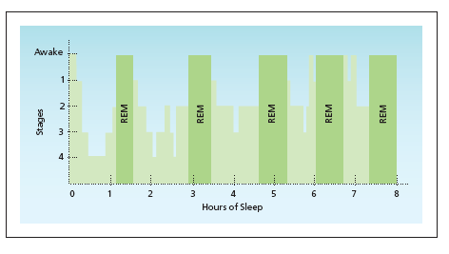
LO 4.4 Stages of sleep
Menu

Slide 17
REM Sleep and Dreaming
LO 4.5 Dreaming and what happens when people do not dream
REM sleep is paradoxical sleep (high level of brain activity).
If wakened during REM sleep, almost always report a dream.
REM rebound - increased amounts of REM sleep after being deprived of REM sleep on earlier nights.
Nightmares - bad dreams occurring during REM sleep.
REM behavior disorder - a rare disorder in which the mechanism that blocks the movement of the voluntary muscles fails, allowing the person to thrash around and even get up and act out nightmares.
Menu

Slide 18
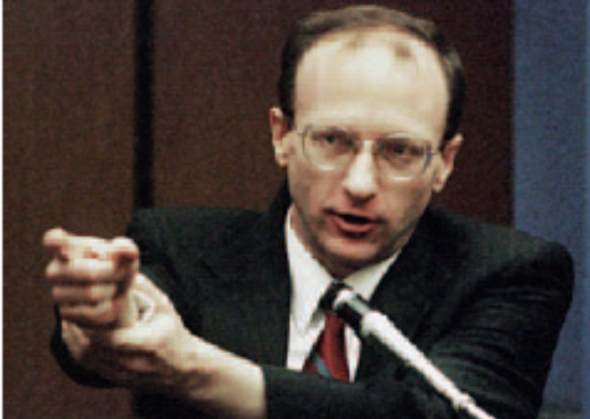
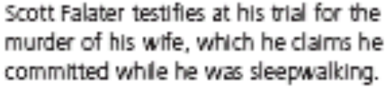
Can Sleepwalking be a Crime Defense?
LO 4.6 Sleepwalking
Steven Steinberg case
Kenneth Parks case
Scott Falater case
Menu

Slide 19
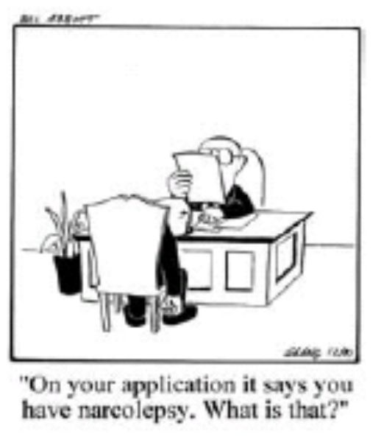
Problems During Sleep
LO 4.7 Problems during sleep
Insomnia - the inability to get to sleep, stay asleep, or get a good quality of sleep.
Sleep apnea - disorder in which the person stops breathing for nearly half a minute or more.
  Continuous positive airway pressure device.
Narcolepsy - sleep disorder in which a person falls immediately into REM sleep during the day without warning.
  Cataplexy – sudden loss of muscle tone.
Menu

Slide 20
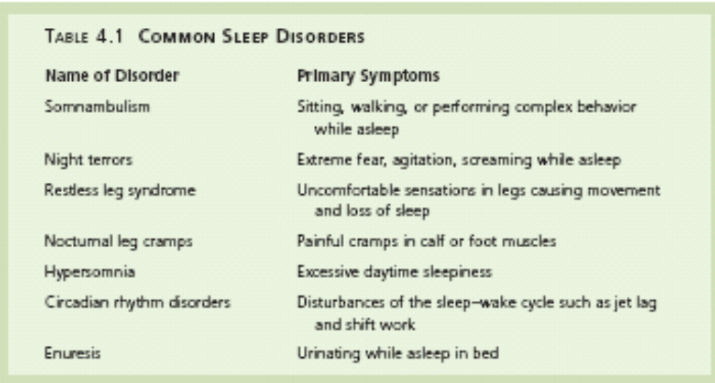
LO 4.4 Problems during sleep
Menu

Slide 21

Dreams
LO 4.8 Why people dream and what they dream about
Freud – dreams as wish fulfillment.
  Manifest content – the actual dream itself.
  Latent content – the true, hidden meaning of a dream.
Activation-synthesis hypothesis - explanation that states that dreams are created by the higher centers of the cortex to explain the activation by the brain stem of cortical cells during REM sleep periods.
Activation-information-mode model (AIM) - revised version of the activation-synthesis explanation of dreams in which information that is accessed during waking hours can have an influence on the synthesis of dreams.
Menu

Slide 22
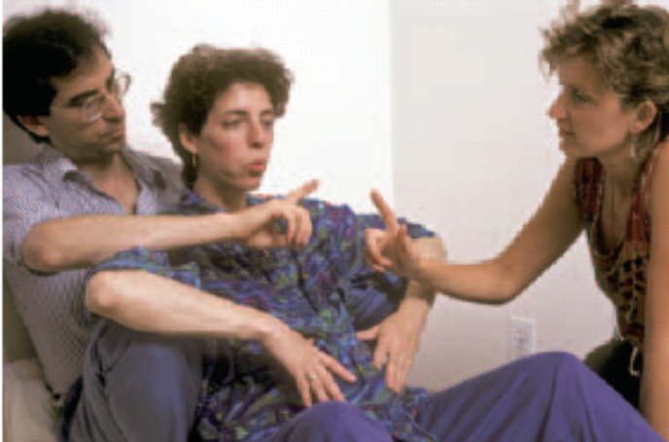
Hypnosis
LO 4.9 Hypnosis and how it works
Hypnosis - state of consciousness in which the person is especially susceptible to suggestion.
Four Elements of Hypnosis:
The hypnotist tells the person to focus on what is being said.
The person is told to relax and feel tired.
The hypnotist tells the person to “let go” and accept suggestions easily.
The person is told to use vivid imagination.
Menu

Slide 23
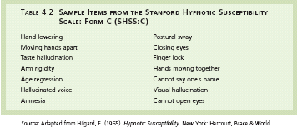
LO 4.9 Hypnosis and how it works
Hypnotic susceptibility – degree to which a person is a good hypnotic subject.
Menu

Slide 24
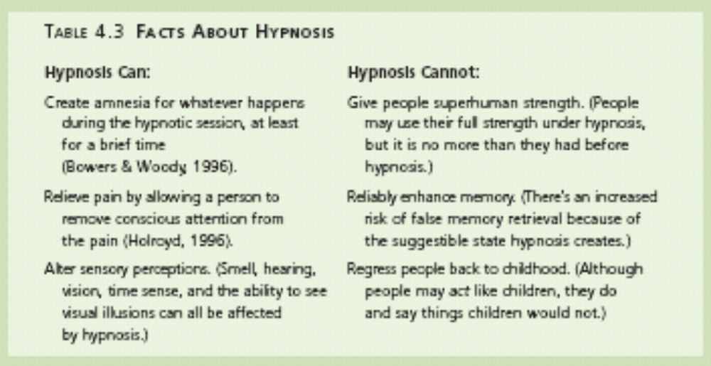
LO 4.9 Hypnosis and how it works
Menu

Slide 25
Theories of Hypnosis
LO 4.9 Hypnosis and how it works
Hypnosis as dissociation – hypnosis works only in a person’s immediate consciousness, while a hidden “observer” remained aware of all that was going on.
Social-cognitive theory of hypnosis - theory that assumes that people who are hypnotized are not in an altered state but are merely playing the role expected of them in the situation.
Menu

Slide 26
Psychoactive Drugs
LO 4.10 Physical and psychological dependence on drugs
Psychoactive drugs - drugs that alter thinking, perception, and memory.
Physical Dependence
  Tolerance – more and more of the drug is needed to achieve the same effect.
  Withdrawal - physical symptoms that can include nausea, pain, tremors, crankiness, and high blood pressure, resulting from a lack of an addictive drug in the body systems.
Psychological dependence - the feeling that a drug is needed to continue a feeling of emotional or psychological well-being.
Menu

Slide 27
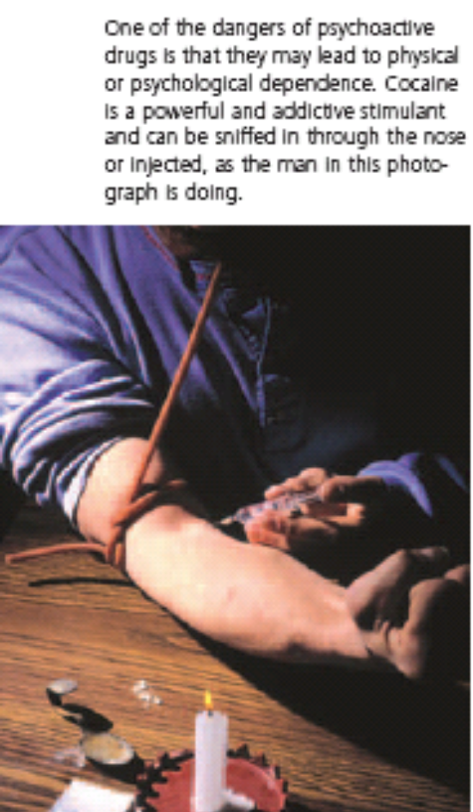
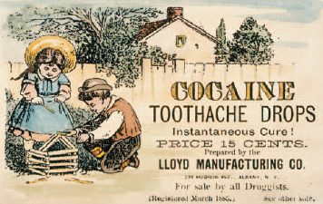
Stimulants
LO 4.11 Stimulants
Stimulants - drugs that increase the functioning of the nervous system.
  Amphetamines – drugs that are synthesized (made in labs) rather than found in nature.
  Cocaine – natural drug; produces euphoria, energy, power, and pleasure.
Menu

Slide 28
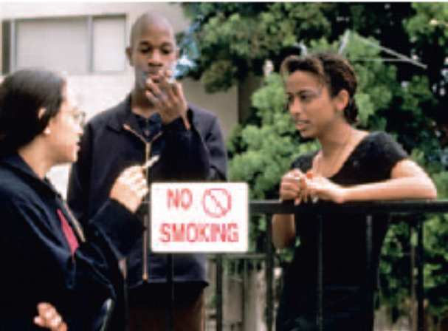
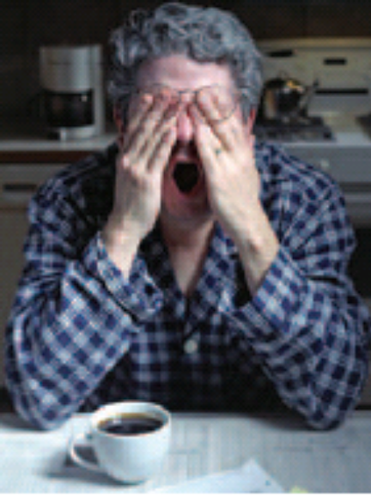
Stimulants
LO 4.11 Stimulants
  Nicotine - active ingredient in tobacco.
  Caffeine - the stimulant found in coffee, tea, most sodas, chocolate, and even many over-the-counter drugs.
Menu

Slide 29

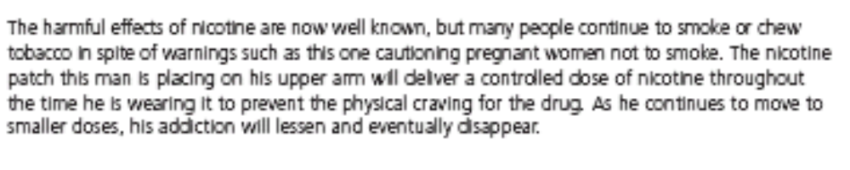
LO 4.11 Stimulants
Menu

Slide 30
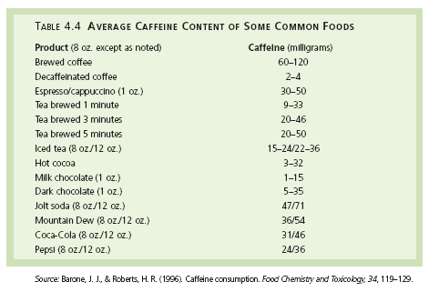
LO 4.11 Stimulants
Menu

Slide 31
Depressants
LO 4.12 Depressants
Depressants - drugs that decrease the functioning of the nervous system.
  Barbituates – depressant drugs that have a sedative effect.
  Benzodiazepines - drugs that lower anxiety and reduce stress.
Menu

Slide 32
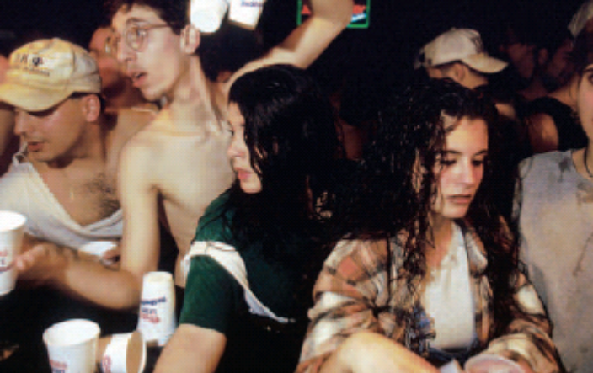
Alcohol
LO 4.13 Alcohol
Alcohol - the chemical resulting from fermentation or distillation of various kinds of vegetable matter.
  Often confused as a stimulant but actually a depressant on CNS.
Menu

Slide 33
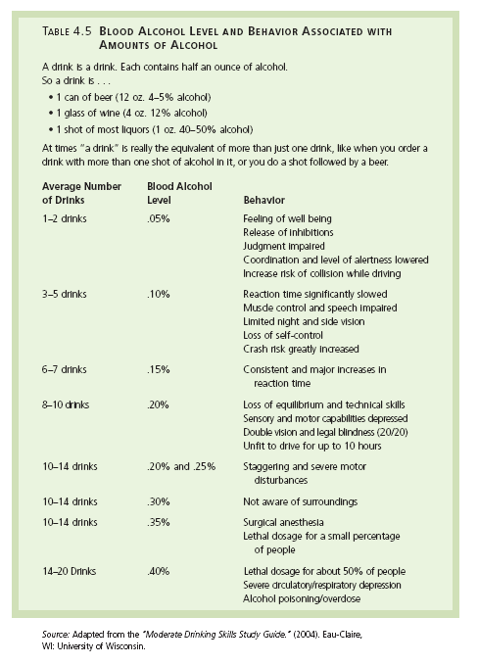
LO 4.13 Alcohol
Menu

Slide 34
Narcotics
LO 4.14 Narcotics
Narcotics - a class of opium-related drugs that suppress the sensation of pain by binding to and stimulating the nervous system’s natural receptor sites for endorphins.
  Opium - substance derived from the opium poppy from which all narcotic drugs are derived.
  Morphine - narcotic drug derived from opium, used to treat severe pain.
  Heroin - narcotic drug derived from opium that is extremely addictive.
Menu

Slide 35
Hallucinogens
LO 4.15 Hallucinogens
Psychogenic drugs - drugs including hallucinogens and marijuana that produce hallucinations or increased feelings of relaxation and intoxication.
  Hallucinogens - drugs that cause false sensory messages, altering the perception of reality.
  LSD (lysergic acid diethylamide) - powerful synthetic hallucinogen.
  PCP - synthesized drug now used as an animal tranquilizer that can cause stimulant, depressant, narcotic, or hallucinogenic effects.
Menu

Slide 36
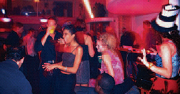

Hallucinogens
LO 4.15 Hallucinogens
  MDMA (Ecstasy or X) - designer drug that can have both stimulant and hallucinatory effects.
  Stimulatory hallucinogenics – drugs that produce a mixture of psychomotor stimulant and hallucinogenic effects.
  Mescaline - natural hallucinogen derived from the peyote cactus buttons.
  Psilocybin - natural hallucinogen found in certain mushrooms.
Menu

Slide 37
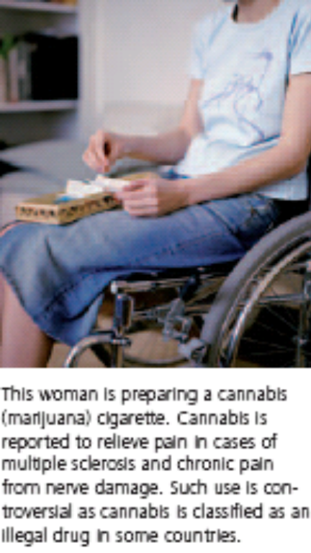
Marijuana
LO 4.16 Marijuana
Marijuana (pot or weed) - mild hallucinogen derived from the leaves and flowers of a particular type of hemp plant.
Menu

Slide 38
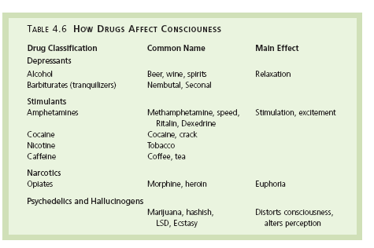
Menu

Slide 39
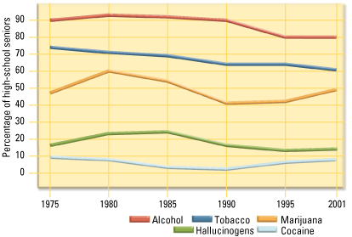
Menu

Slide 40
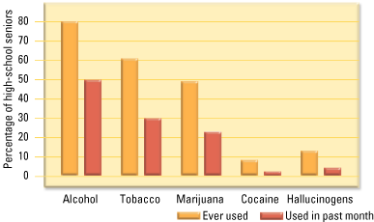
Menu

